Slide 1

Malware Detection using Machine Learning Phase 1
Nikhil Goparapu
Data 606 – Spring 2021
Instructor: Dr. Murat Guner

Slide 2
Business Problem
In the past few years, the malware industry has grown very rapidly, forcing the anti-malware groups/communities to build more robust software's to detect and terminate these attacks.
Many organizations around the world are investing heavily in technologies and methods to build a system to detect and deactivate these malware files.

Slide 3
Project Goal
Here, The Goal of the project is to build a mechanism that accurately classifies a malware file to the family it belongs to.

Slide 4
Data Description
The dataset consists of 10,868 .bytes files and 10,868 asm files.
The data is open sourced by Microsoft and is available to download from Kaggle.
The dataset consists of 9 classes. They are: Ramnit, Lollipop, Kelihos_ver3, Vundo, Simda, Tracur, Kelihos_ver1, Obfuscator.ACY, Gatak.
Notes:
I have collected the data from the Kaggle. Microsoft has open-sourced the dataset as a part of a competition on Kaggle. It can be used for educational and research purposes.
The dataset consists of 10,868 bytes file in a hexadecimal representation and 10,868 asm files.
The files in the dataset represent a mix of 9 different families of malware.
A file may belong to any of the following 9 classes of malware

Slide 5
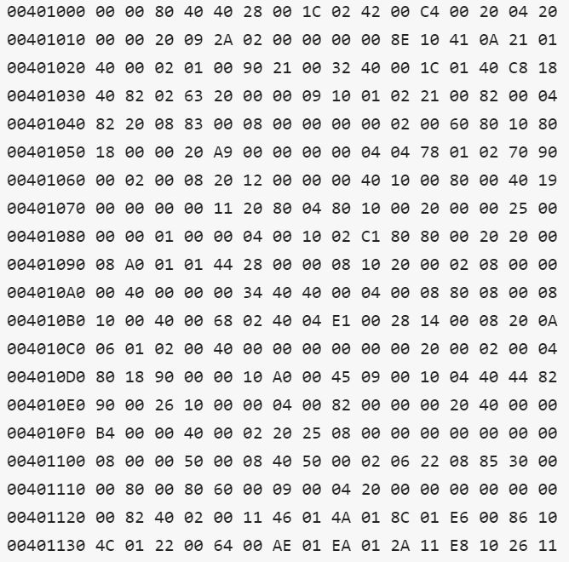
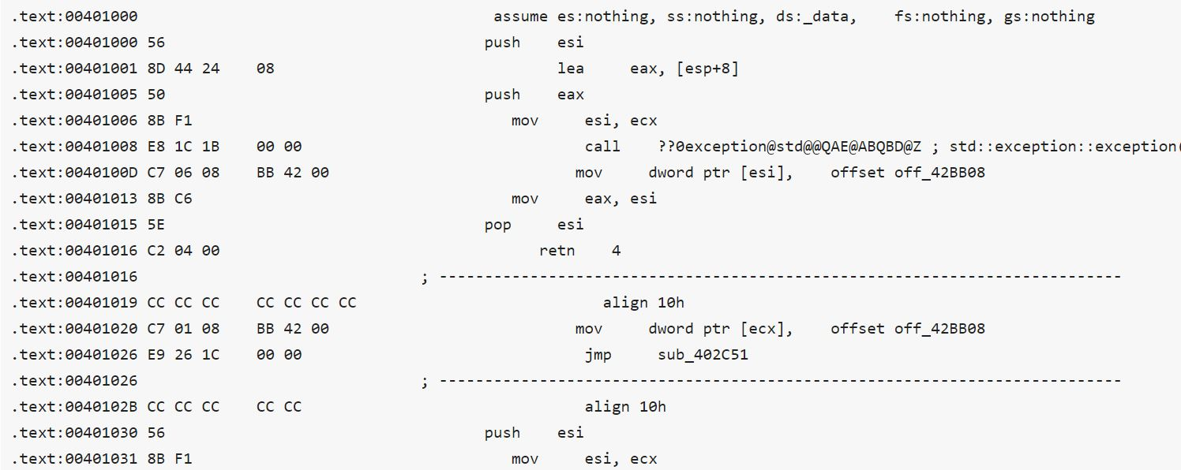
Snapshot of the byte file
Snapshot of .asm file

Slide 6
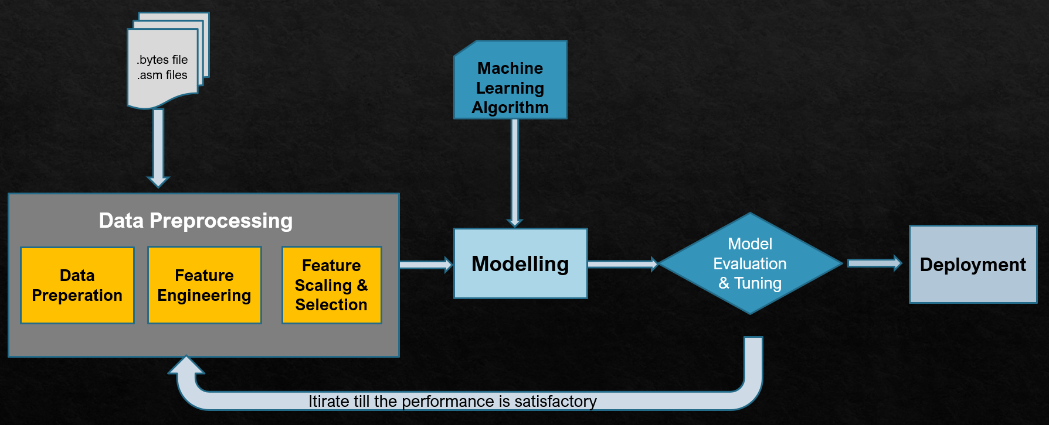
Methodology

Slide 7
Evaluation Metrices
Multi-class logloss
Confusion Matrix
Accuracy

